Slide 1
Savannah
ALUMNAE CHAPTER
GA

Slide 2
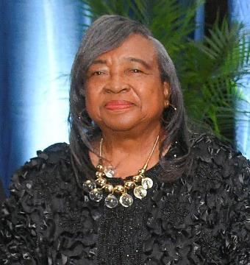
GOLDEN DELTA D.E.A.R.S.
Jacquelyn W. Stephens
PASTE A PICTURE
Year of Initiation: 1958
Chapter of Initiation: Delta Nu – Savannah State University
Current Chapter: Savannah Alumnae Chapter

Slide 3
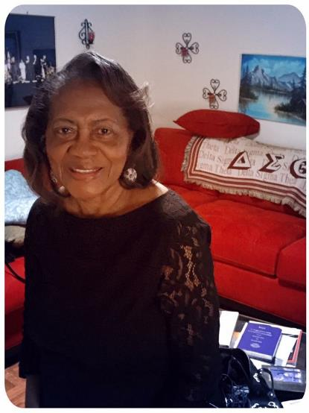
GOLDEN DELTA D.E.A.R.S.
MaryAnn Jones
PASTE A PICTURE
Year of Initiation: 1952
Chapter of Initiation: Delta Nu (Savannah State University
Current Chapter: Savannah Alumnae Chapter

Slide 4
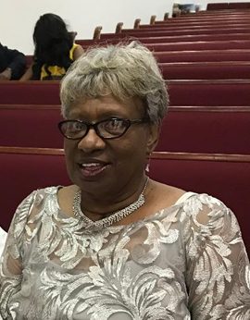
GOLDEN DELTA D.E.A.R.S.
Bettye J. Scott Ector
PASTE A PICTURE
Year of Initiation: 1963
Chapter of Initiation: Eta Chapter (Fort Valley State University)
Current Chapter: Savannah Alumnae Chapter

Slide 5
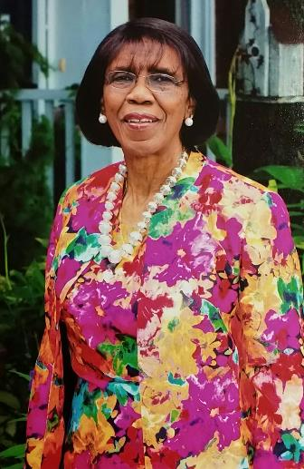
GOLDEN DELTA D.E.A.R.S.
Frankie Washington
PASTE A PICTURE
Year of Initiation: 1957
Chapter of Initiation: Delta Nu (Savannah State University)
Current Chapter: Savannah Alumnae Chapter

Slide 6
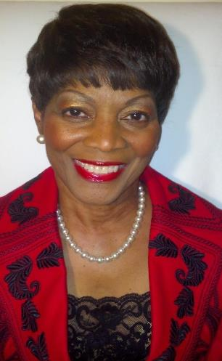
GOLDEN DELTA D.E.A.R.S.
Anna C. Watson
PASTE A PICTURE
Year of Initiation: 1960
Chapter of Initiation: Delta Nu (Savannah State University)
Current Chapter: Savannah Alumnae Chapter

Slide 7
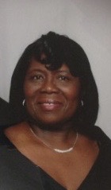
GOLDEN DELTA D.E.A.R.S.
Ruth C. Wright
PASTE A PICTURE
Year of Initiation: 1965
Chapter of Initiation: Delta Nu (Savannah State University)
Current Chapter: Savannah Alumnae Chapter

Slide 8
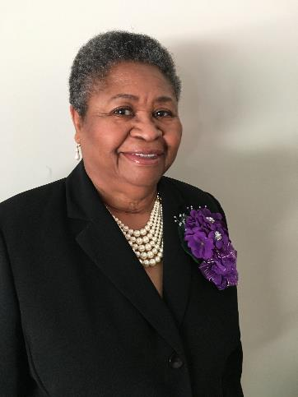
GOLDEN DELTA D.E.A.R.S.
Alice Brown Holloway
PASTE A PICTURE
Year of Initiation: 1967
Chapter of Initiation: Delta Rho (Albany State University)
Current Chapter: Savannah Alumnae Chapter

Slide 9
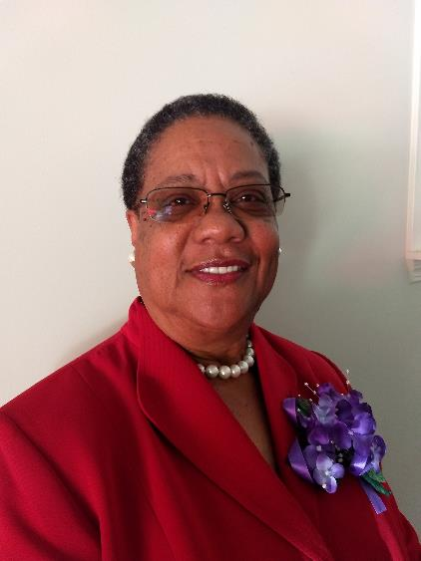
GOLDEN DELTA D.E.A.R.S.
Gloria Perkins Lewis
PASTE A PICTURE
Year of Initiation: 1969
Chapter of Initiation: Delta Nu (Savannah State University)
Current Chapter: Savannah Alumnae Chapter

Slide 10
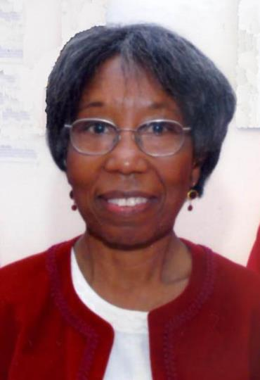
GOLDEN DELTA D.E.A.R.S.
Gladys Lambert
PASTE A PICTURE
Year of Initiation: 1958
Chapter of Initiation: Delta Nu (Savannah State University)
Current Chapter: Savannah Alumnae Chapter

Slide 11
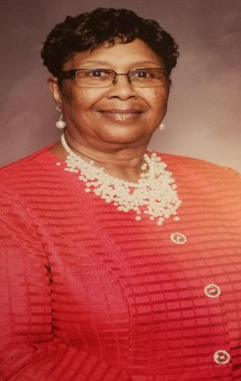
GOLDEN DELTA D.E.A.R.S.
Jerelene Parish Williams
PASTE A PICTURE
Year of Initiation: 1969
Chapter of Initiation: Delta Nu (Savannah State University)
Current Chapter: Savannah Alumnae Chapter

Slide 12
GOLDEN DELTA D.E.A.R.S.
Ella Marie Harmon
PASTE A PICTURE
Year of Initiation: 1969
Chapter of Initiation: Delta Nu (Savannah State University)
Current Chapter: Savannah Alumnae Chapter

Slide 13
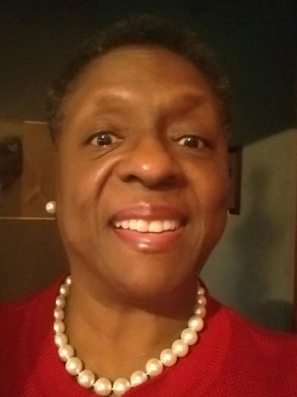
GOLDEN DELTA D.E.A.R.S.
Virginia Juanita Young Morrison
PASTE A PICTURE
Year of Initiation: 1969
Chapter of Initiation: Delta Nu (Savannah State University)
Current Chapter: Savannah Alumnae Chapter

Slide 14
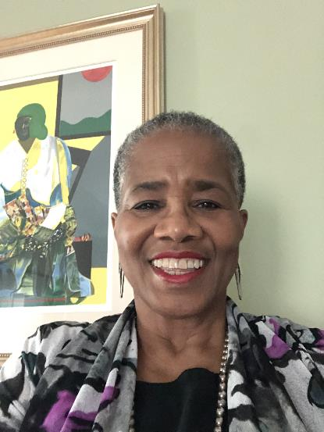
GOLDEN DELTA D.E.A.R.S.
Michele Bolden
PASTE A PICTURE
Year of Initiation: 1970
Chapter of Initiation: Iota
Current Chapter: Savannah Alumnae Chapter

Slide 15
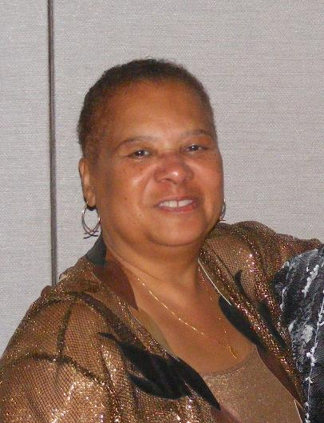
GOLDEN DELTA D.E.A.R.S.
Angela Stone
PASTE A PICTURE
Year of Initiation: 1970
Chapter of Initiation: Alpha Beta (Fisk University)
Current Chapter: Savannah Alumnae Chapter

Slide 16
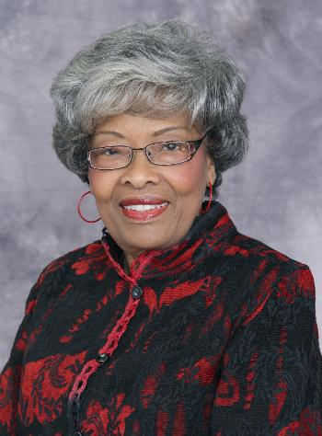
GOLDEN DELTA D.E.A.R.S.
Lydia D. Mungin Harris
PASTE A PICTURE
Year of Initiation: 1966
Chapter of Initiation: Delta Nu (Savannah State University)
Current Chapter: Savannah Alumnae Chapter

Slide 17
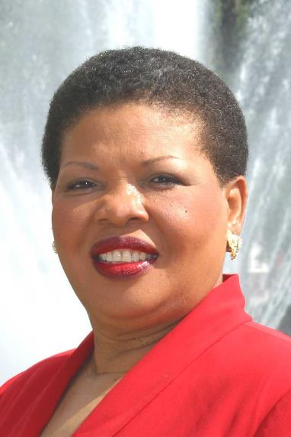
GOLDEN DELTA D.E.A.R.S.
Juanita Adams
PASTE A PICTURE
Year of Initiation: 1966
Chapter of Initiation: Delta Nu (Savannah State University)
Current Chapter: Savannah Alumnae Chapter

Slide 18
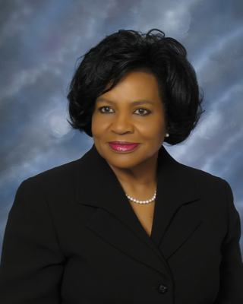
GOLDEN DELTA D.E.A.R.S.
Lula LeCounte Baker
PASTE A PICTURE
Year of Initiation: 1965
Chapter of Initiation: Delta Nu (Savannah State University)
Current Chapter: Savannah Alumnae Chapter

Slide 19
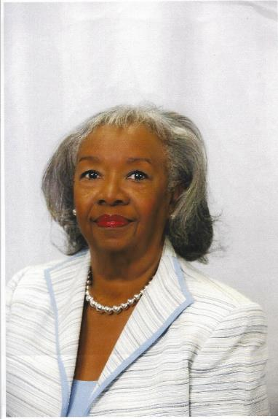
GOLDEN DELTA D.E.A.R.S.
Marguerite Birt
PASTE A PICTURE
Year of Initiation: 1958
Chapter of Initiation: Delta Nu (Savannah State University)
Current Chapter: Savannah Alumnae Chapter

